Slide 1
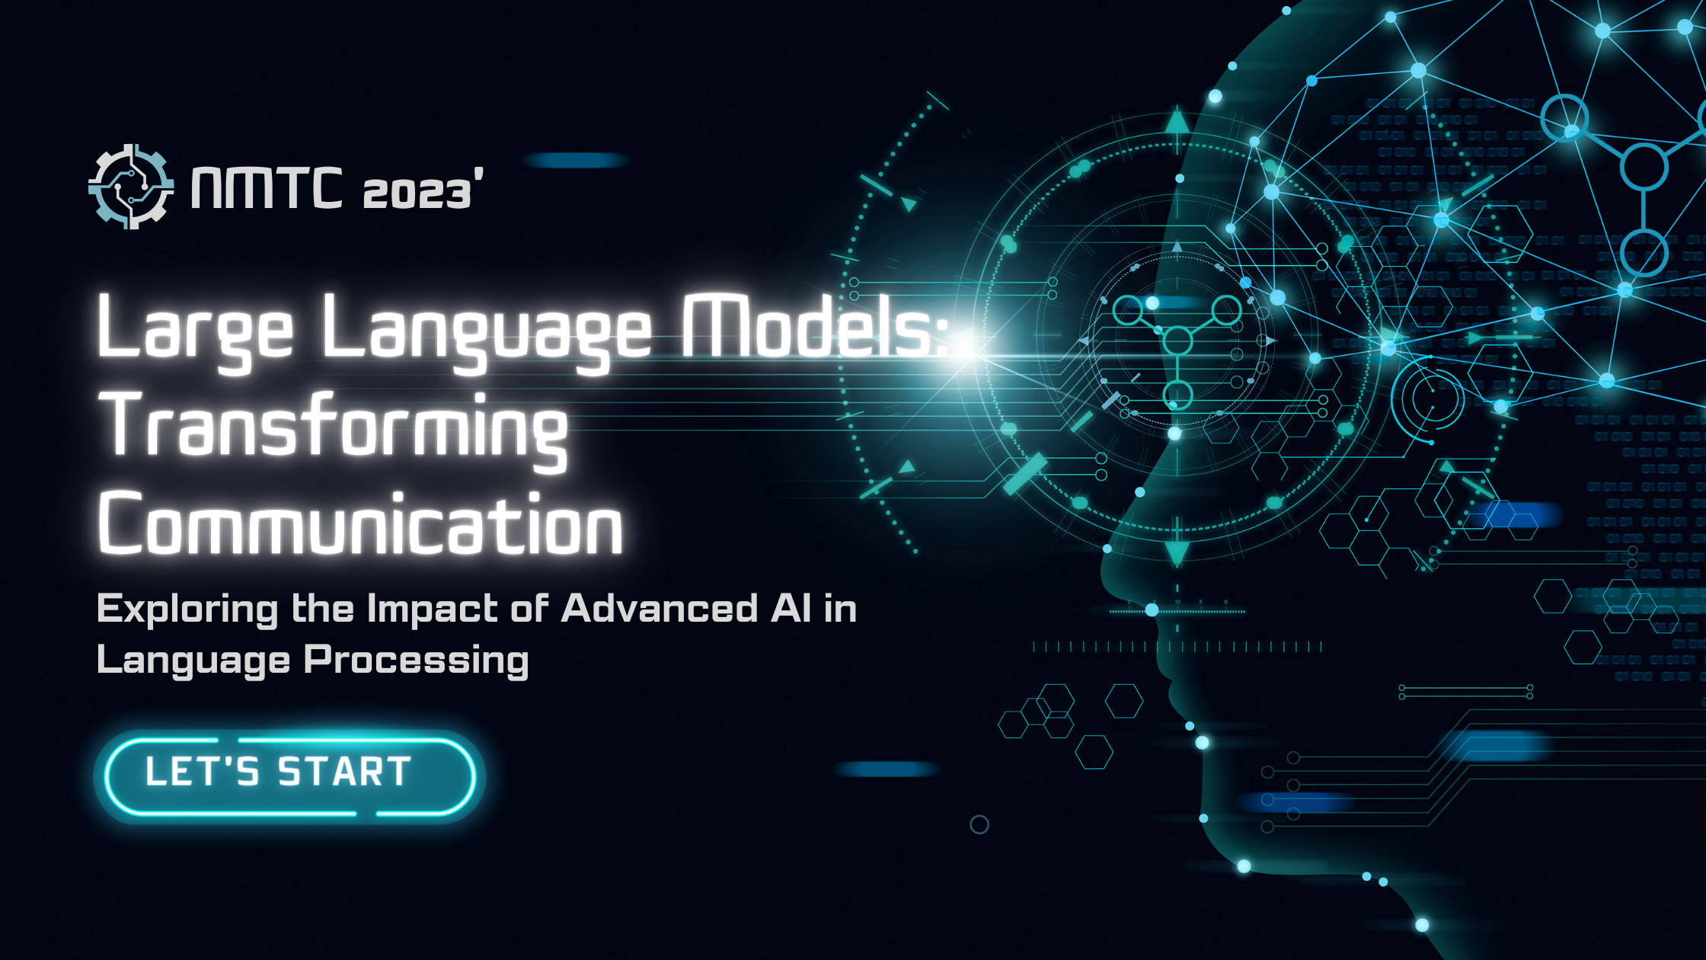

Slide 2


Slide 3
AGENDA
Exploring the Impact of Advanced AI in Language Processing
1
2
3
4
Introduction
Evolution of LLMs
How LLMs Work
Applications of LLMs
5
6
7
Ethical Considerations
Advantages and Limitations
Future Potential & Public Perception and Acceptance

Slide 4
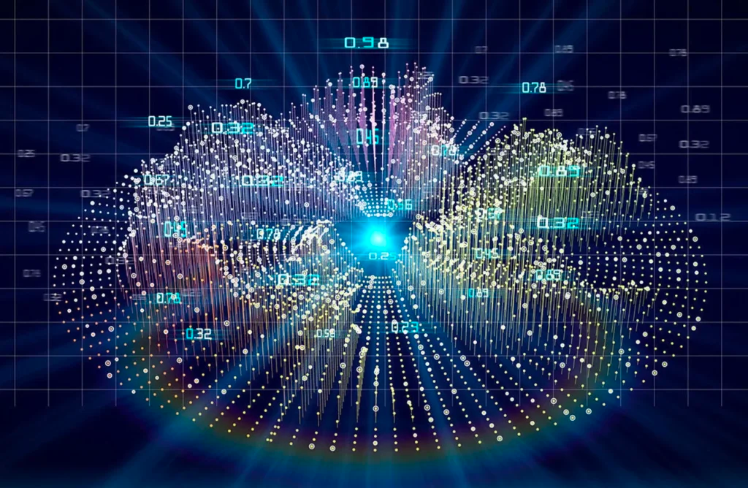
Introduction
Exploring the Impact of Advanced AI in Language Processing
1
Definition of Large Language Models (LLMs)
2
Overview of their significance in AI development
3
Importance of language comprehension in modern technology

Slide 5
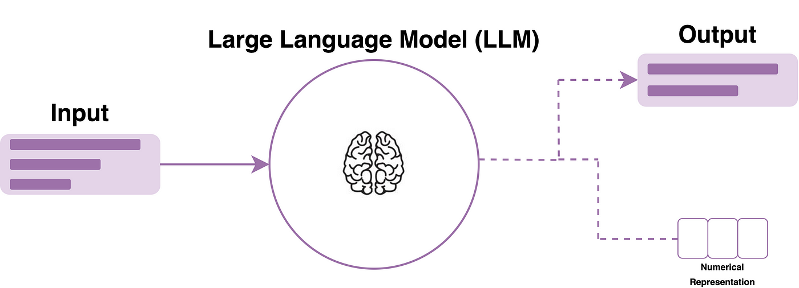

Slide 6

Title: Definition of Large Language Models (LLMs)
LARGE LANGUAGE MODELS (LLMS) REPRESENT A BREAKTHROUGH IN ARTIFICIAL INTELLIGENCE, ENCOMPASSING POWERFUL NEURAL NETWORKS TRAINED ON EXTENSIVE DATASETS. THESE MODELS, SUCH AS GPT (GENERATIVE PRE-TRAINED TRANSFORMER), ARE CAPABLE OF UNDERSTANDING, PROCESSING, AND GENERATING HUMAN-LIKE TEXT. THEY UTILIZE DEEP LEARNING TECHNIQUES AND MASSIVE AMOUNTS OF TEXT DATA TO COMPREHEND CONTEXT, STRUCTURE, AND LINGUISTIC PATTERNS.
National Microsoft Tech Camp 2023

Slide 7
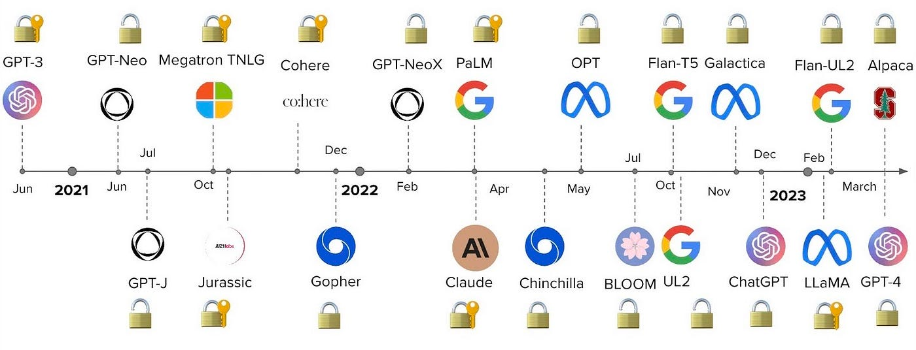

Slide 8
Title: Overview of their Significance in AI Development
THE EMERGENCE OF LLMS SIGNIFIES A MONUMENTAL ADVANCEMENT IN AI DEVELOPMENT. THESE MODELS HAVE SHIFTED THE LANDSCAPE OF NATURAL LANGUAGE PROCESSING, ENABLING MACHINES TO COMPREHEND AND GENERATE LANGUAGE WITH IMPRESSIVE ACCURACY. THEY'VE REVOLUTIONIZED VARIOUS LANGUAGE-RELATED TASKS, INCLUDING TEXT GENERATION, TRANSLATION, SUMMARIZATION, AND SENTIMENT ANALYSIS. THEIR SIGNIFICANCE LIES IN THEIR ABILITY TO UNDERSTAND CONTEXT, NUANCES, AND COMPLEXITIES OF HUMAN LANGUAGE, MARKING A CRUCIAL MILESTONE IN AI EVOLUTION.
National Microsoft Tech Camp 2023

Slide 9
Title: Importance of Language Comprehension in Modern Technology
LANGUAGE COMPREHENSION HOLDS IMMENSE IMPORTANCE IN MODERN TECHNOLOGY. LLMS PLAY A PIVOTAL ROLE IN BRIDGING THE GAP BETWEEN HUMAN COMMUNICATION AND TECHNOLOGICAL INTERACTION. THEIR PROFICIENCY IN COMPREHENDING LANGUAGE NUANCES FACILITATES MORE INTUITIVE AND EFFECTIVE HUMAN-COMPUTER INTERACTIONS. THIS CAPABILITY ENHANCES USER EXPERIENCES ACROSS APPLICATIONS, FROM CHATBOTS AND VIRTUAL ASSISTANTS TO CONTENT CURATION AND INFORMATION RETRIEVAL SYSTEMS. LLMS SIGNIFICANTLY CONTRIBUTE TO MAKING TECHNOLOGY MORE ACCESSIBLE, EFFICIENT, AND USER-FRIENDLY IN OUR DIGITAL LANDSCAPE.
National Microsoft Tech Camp 2023

Slide 10

Evolution of LLMs
Exploring the Impact of Advanced AI in Language Processing
Introduction of transformer architectures
development stages
1
3
5
2
4
Historical background
ML vs LLM
Key advancements leading to modern LLMs

Slide 11
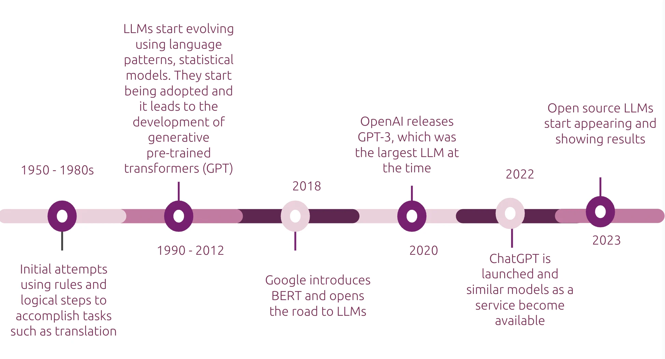

Slide 12
Title: Historical Background and Development Stages
THE EVOLUTION OF LARGE LANGUAGE MODELS (LLMS) TRACES BACK TO EARLY DEVELOPMENTS IN ARTIFICIAL INTELLIGENCE AND NATURAL LANGUAGE PROCESSING. INITIAL STAGES INVOLVED FOUNDATIONAL RESEARCH IN MACHINE LEARNING AND LANGUAGE MODELING. OVER TIME, ADVANCEMENTS IN NEURAL NETWORK ARCHITECTURES PAVED THE WAY FOR MORE SOPHISTICATED MODELS CAPABLE OF HANDLING VAST AMOUNTS OF TEXTUAL DATA.
National Microsoft Tech Camp 2023

Slide 13
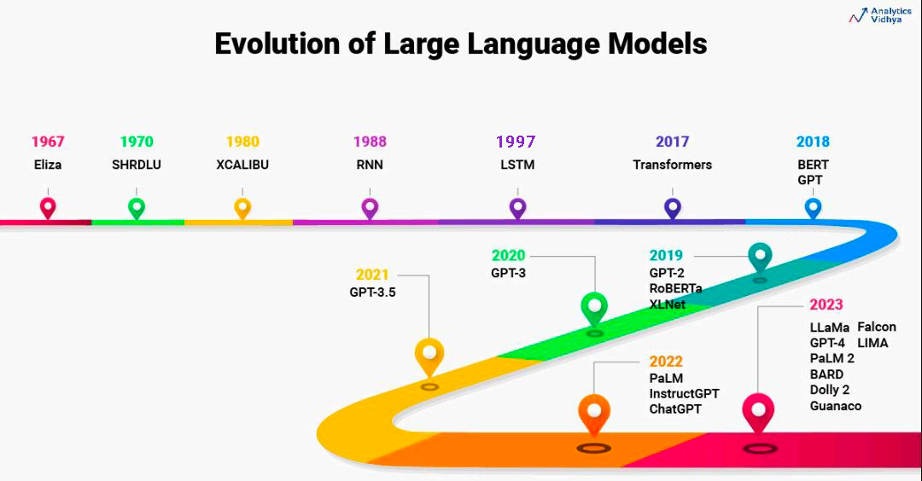

Slide 14
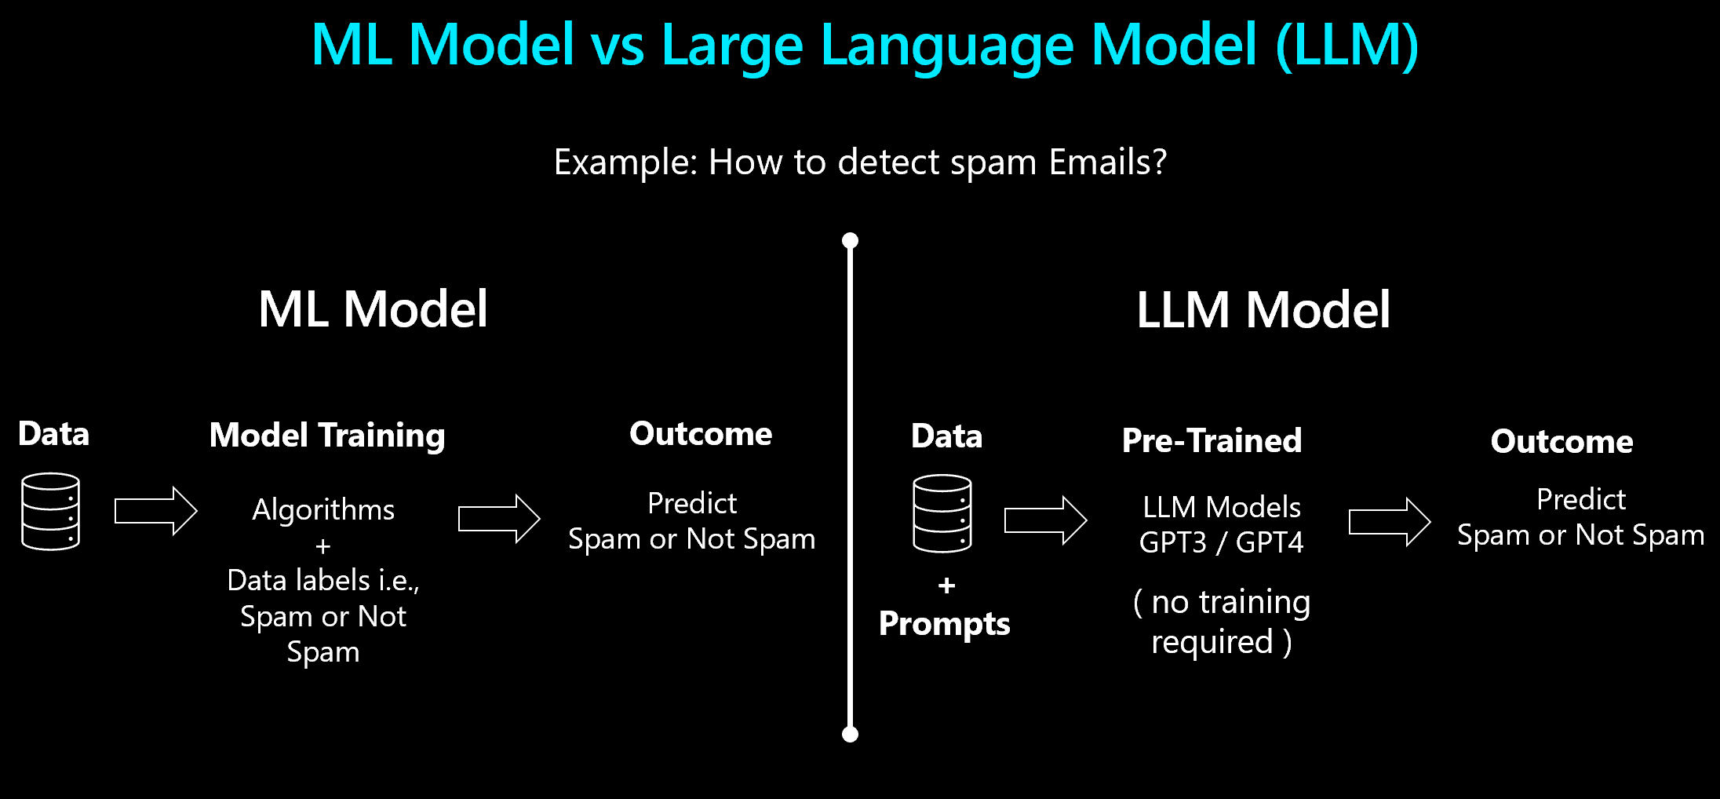

Slide 15
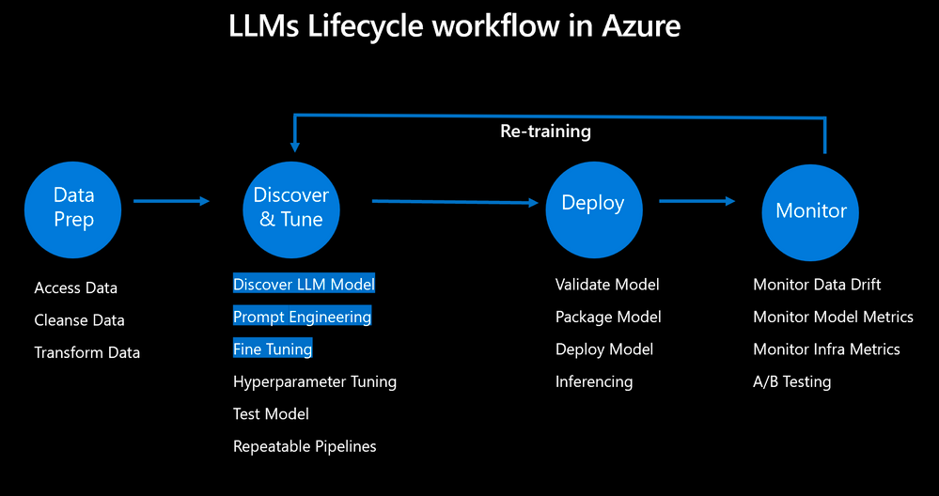

Slide 16
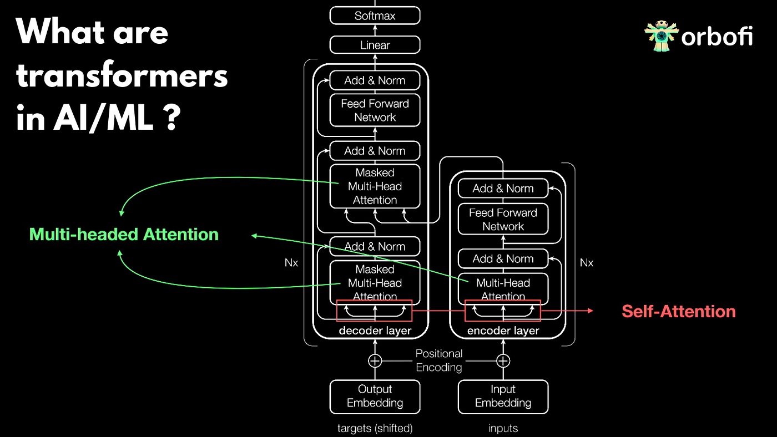

Slide 17
Title: Introduction of Transformer Architectures
A SIGNIFICANT TURNING POINT IN THE EVOLUTION OF LLMS WAS THE INTRODUCTION OF TRANSFORMER ARCHITECTURES. THIS INNOVATIVE FRAMEWORK, NOTABLY HIGHLIGHTED IN THE TRANSFORMER MODEL, REVOLUTIONIZED LANGUAGE PROCESSING BY ENABLING MORE EFFICIENT LEARNING OF CONTEXTUAL RELATIONSHIPS WITHIN TEXT. TRANSFORMERS, WITH THEIR ATTENTION MECHANISMS, FACILITATED PARALLEL COMPUTATION AND IMPROVED THE UNDERSTANDING OF LONG-RANGE DEPENDENCIES, LAYING THE GROUNDWORK FOR MORE COMPLEX AND EFFECTIVE LANGUAGE MODELS
National Microsoft Tech Camp 2023

Slide 18
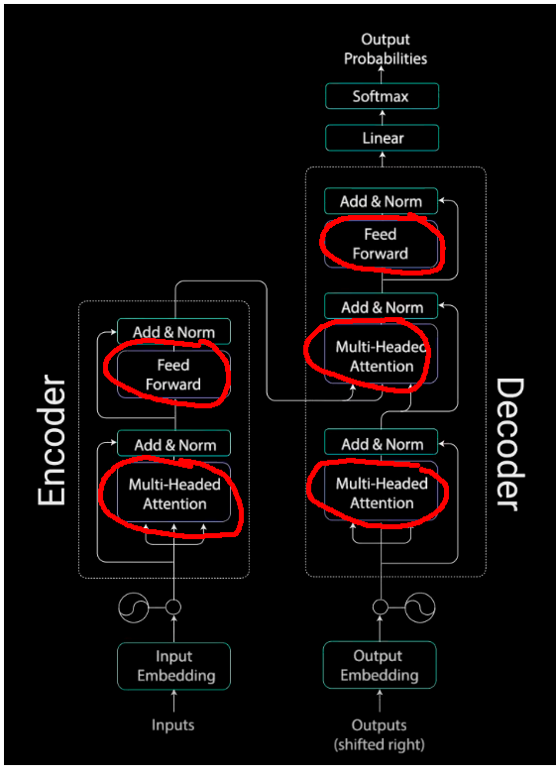

Slide 19
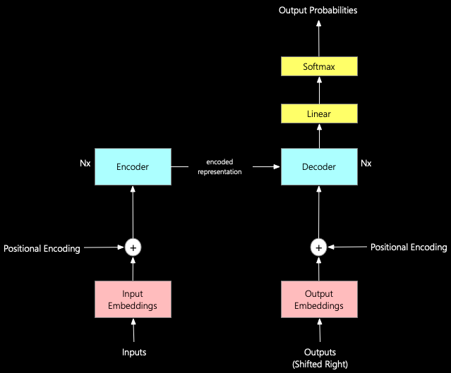

Slide 20
Title: Key Advancements Leading to Modern LLMs
THE JOURNEY TOWARD MODERN LLMS HAS BEEN CHARACTERIZED BY PIVOTAL ADVANCEMENTS. THE REFINEMENT OF TRAINING TECHNIQUES, THE UTILIZATION OF LARGER AND MORE DIVERSE DATASETS, AND THE OPTIMIZATION OF MODEL ARCHITECTURES HAVE BEEN INSTRUMENTAL. BREAKTHROUGHS IN UNSUPERVISED PRE-TRAINING AND FINE-TUNING METHODOLOGIES HAVE SIGNIFICANTLY BOOSTED THE PERFORMANCE AND CAPABILITIES OF LLMS, ALLOWING FOR MORE ACCURATE LANGUAGE UNDERSTANDING, GENERATION, AND TASK-SPECIFIC ADAPTATIONS. THESE ADVANCEMENTS HAVE CULMINATED IN THE CREATION OF STATE-OF-THE-ART MODELS LIKE GPT-3, SHOWCASING UNPRECEDENTED LANGUAGE PROCESSING CAPABILITIES.
National Microsoft Tech Camp 2023

Slide 21
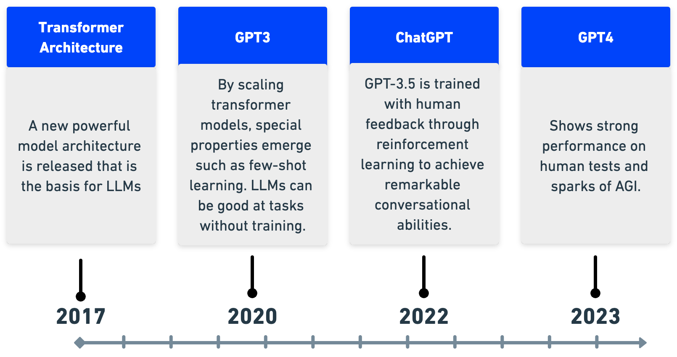

Slide 22
Title: Explanation of the Functioning of LLMs
LARGE LANGUAGE MODELS (LLMS) OPERATE THROUGH COMPLEX NEURAL NETWORK ARCHITECTURES DESIGNED TO UNDERSTAND AND GENERATE HUMAN-LIKE TEXT. THESE MODELS LEVERAGE TRANSFORMER-BASED ARCHITECTURES, UTILIZING LAYERS OF NEURONS THAT PROCESS INPUT TEXT IN SEQUENTIAL STAGES. THROUGH A SERIES OF COMPUTATIONS AND TRANSFORMATIONS, LLMS INTERPRET THE CONTEXT, SEMANTICS, AND SYNTAX OF LANGUAGE, ENABLING THEM TO GENERATE COHERENT AND CONTEXTUALLY RELEVANT RESPONSES.
National Microsoft Tech Camp 2023

Slide 23
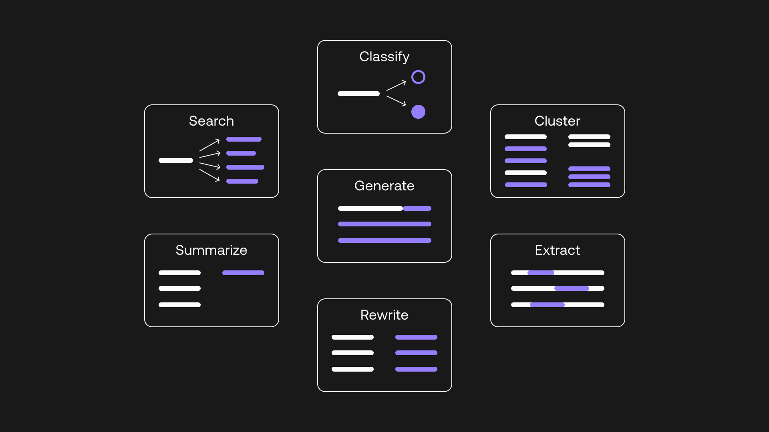

Slide 24
Title: Insight into Transformer Models and Their Mechanisms
AT THE CORE OF LLMS, TRANSFORMER MODELS EMPLOY ATTENTION MECHANISMS TO PROCESS INPUT DATA. THESE MECHANISMS ENABLE THE MODEL TO WEIGH AND PRIORITIZE DIFFERENT PARTS OF THE INPUT TEXT, FOCUSING ON CRUCIAL ELEMENTS WHILE CONSIDERING THE ENTIRE CONTEXT. BY ATTENDING TO RELEVANT SEGMENTS AND RELATIONSHIPS WITHIN THE TEXT, TRANSFORMERS CAN CAPTURE DEPENDENCIES, UNDERSTAND CONTEXT, AND GENERATE RESPONSES THAT ALIGN WITH THE INPUT CONTEXT, LEADING TO MORE COHERENT AND CONTEXTUALLY RELEVANT OUTPUTS.
National Microsoft Tech Camp 2023

Slide 25
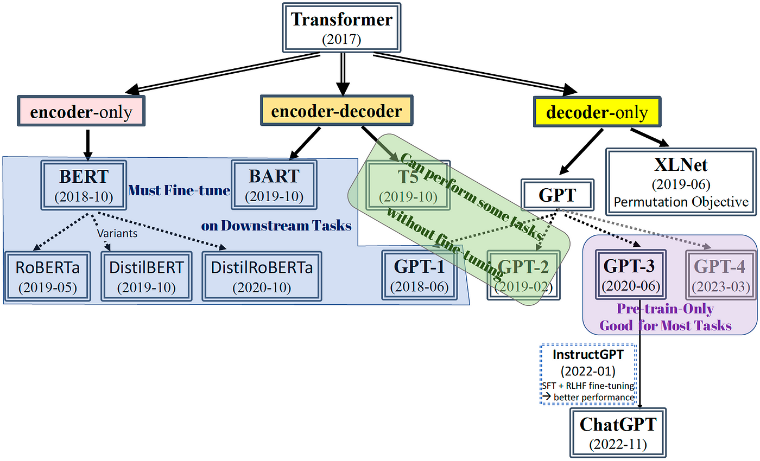

Slide 26
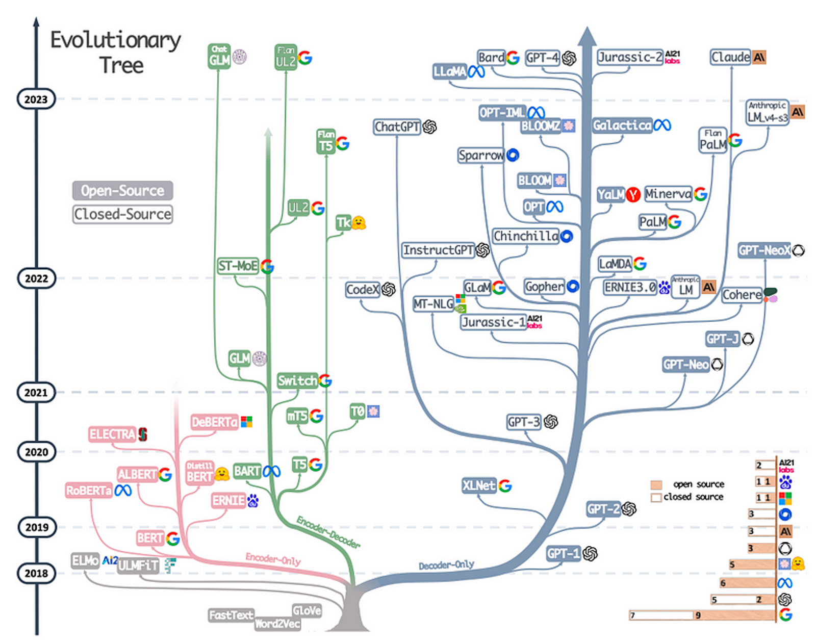

Slide 27
Title: Role of Training Data in Model Comprehension
THE TRAINING DATA FORMS THE BEDROCK OF LLM COMPREHENSION. THESE MODELS ARE TRAINED ON VAST AND DIVERSE DATASETS COMPRISING TEXT FROM VARIOUS SOURCES, INCLUDING BOOKS, ARTICLES, WEBSITES, AND MORE. THE QUALITY, QUANTITY, AND DIVERSITY OF THIS TRAINING DATA SIGNIFICANTLY INFLUENCE THE MODEL'S LANGUAGE COMPREHENSION CAPABILITIES. THROUGH EXPOSURE TO DIVERSE LINGUISTIC PATTERNS AND CONTEXTS, LLMS LEARN TO RECOGNIZE AND REPLICATE LANGUAGE STRUCTURES, IMPROVING THEIR ABILITY TO UNDERSTAND AND GENERATE HUMAN-LIKE TEXT.
National Microsoft Tech Camp 2023

Slide 28





Applications of LLMs
Exploring the Impact of Advanced AI in Language Processing
5
Large Language Models (LLMs) have found widespread applications across numerous fields due to their versatile language processing capabilities.
2
1
LLMs excel in various language-related tasks, including but not limited to text generation, translation, summarization, and sentiment analysis
These models are utilized in industries such as healthcare, finance, education, and entertainment, among others.
3
4
Impact on Customer Service, Content Creation, and Data Analysis
These capabilities have transformed how information is processed, shared, and understood across different languages and contexts.

Slide 29
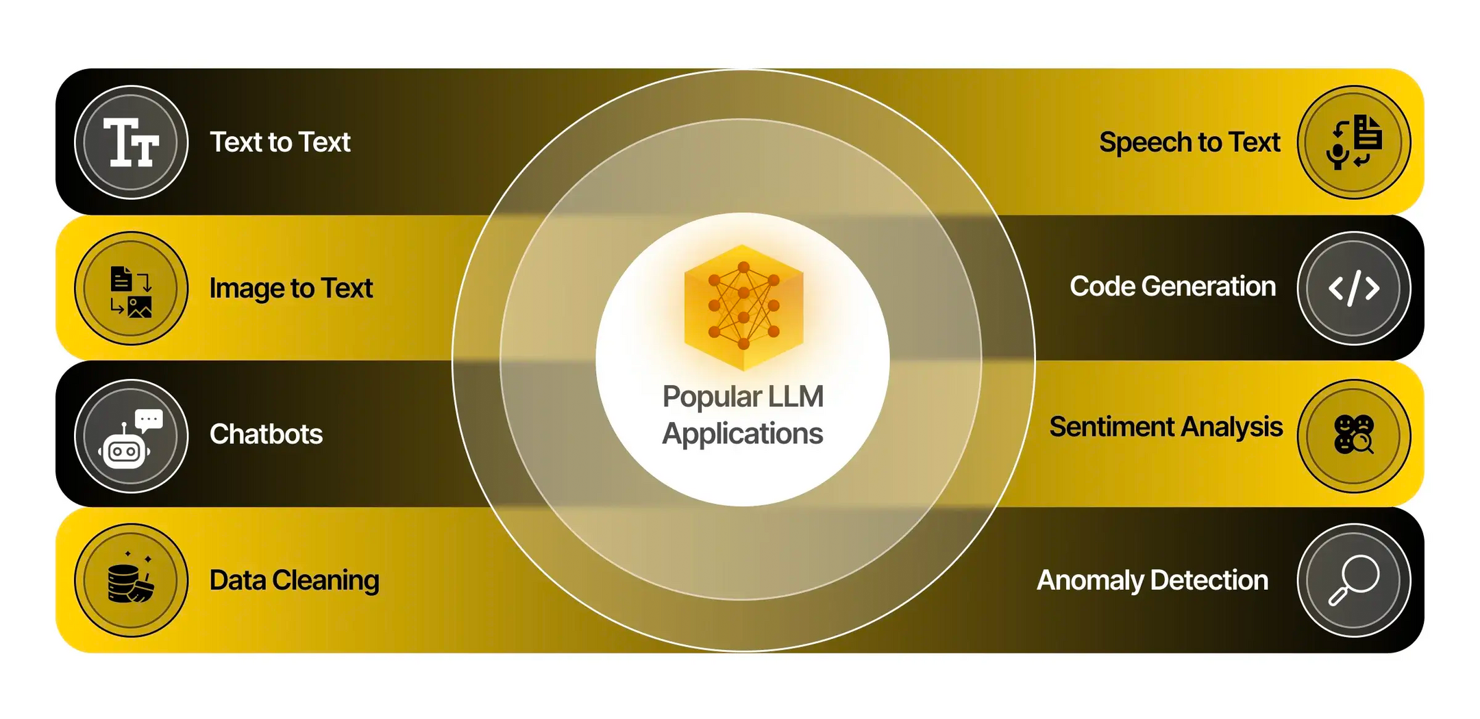

Slide 30
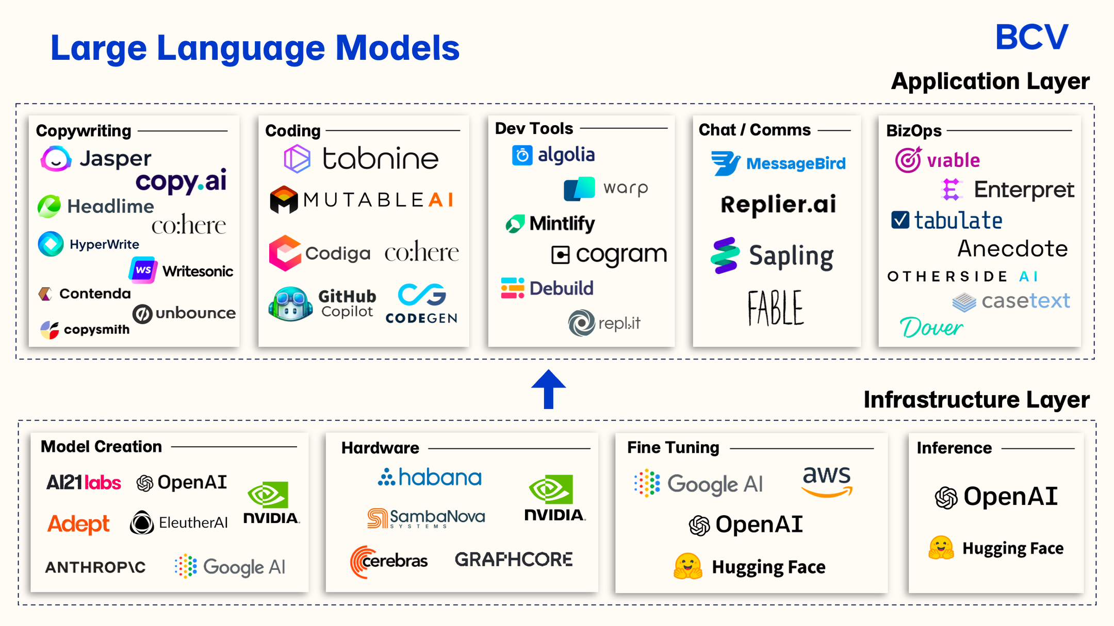

Slide 31
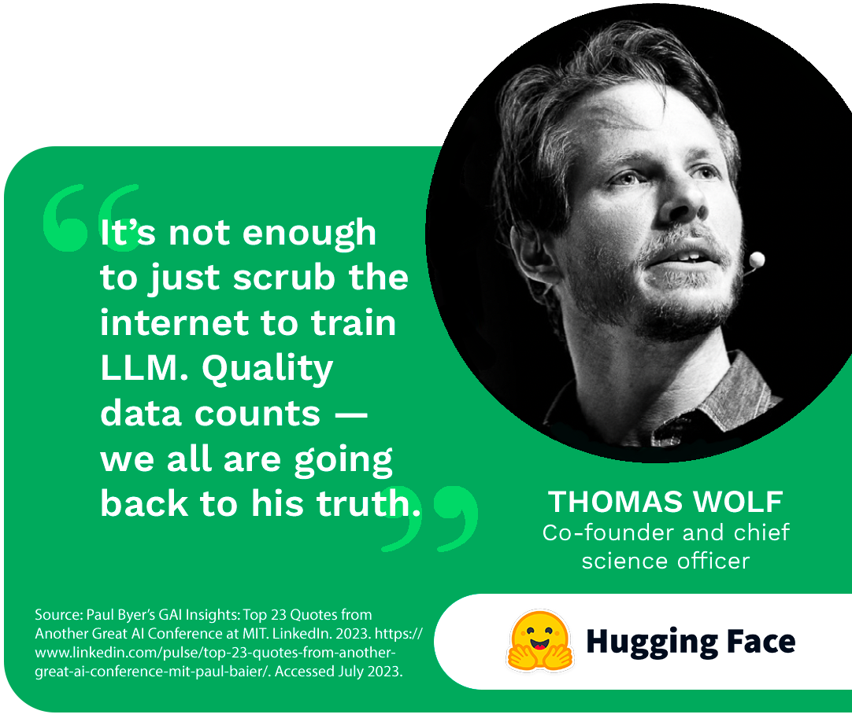

Slide 32
Title: Ethical Challenges Associated with LLMs
THE INTEGRATION OF LARGE LANGUAGE MODELS (LLMS) INTO VARIOUS APPLICATIONS RAISES SIGNIFICANT ETHICAL CONCERNS. THESE MODELS, WHILE POWERFUL IN LANGUAGE PROCESSING, ARE SUSCEPTIBLE TO INHERENT BIASES PRESENT IN THE TRAINING DATA. BIASES, BOTH SOCIETAL AND LINGUISTIC, CAN PERPETUATE AND AMPLIFY EXISTING INEQUALITIES, LEADING TO BIASED OUTPUTS OR DISCRIMINATORY LANGUAGE PATTERNS IN GENERATED TEXT. ADDITIONALLY, CONCERNS ARISE REGARDING THE ETHICAL RESPONSIBILITY OF THOSE DEPLOYING THESE MODELS IN VARIOUS APPLICATIONS.
National Microsoft Tech Camp 2023

Slide 33
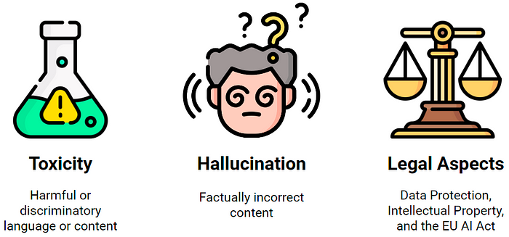

Slide 34
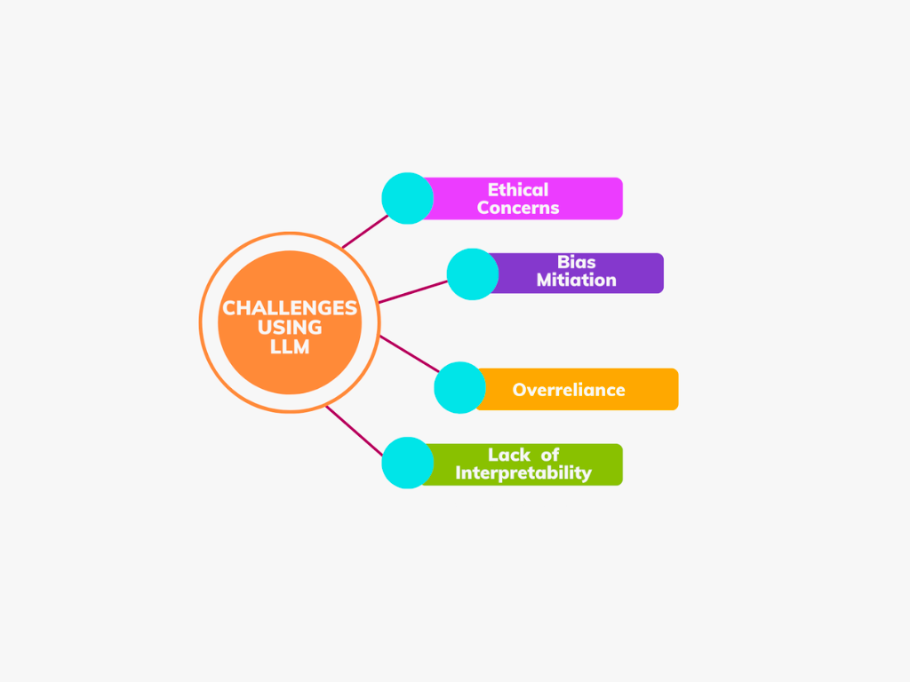

Slide 35
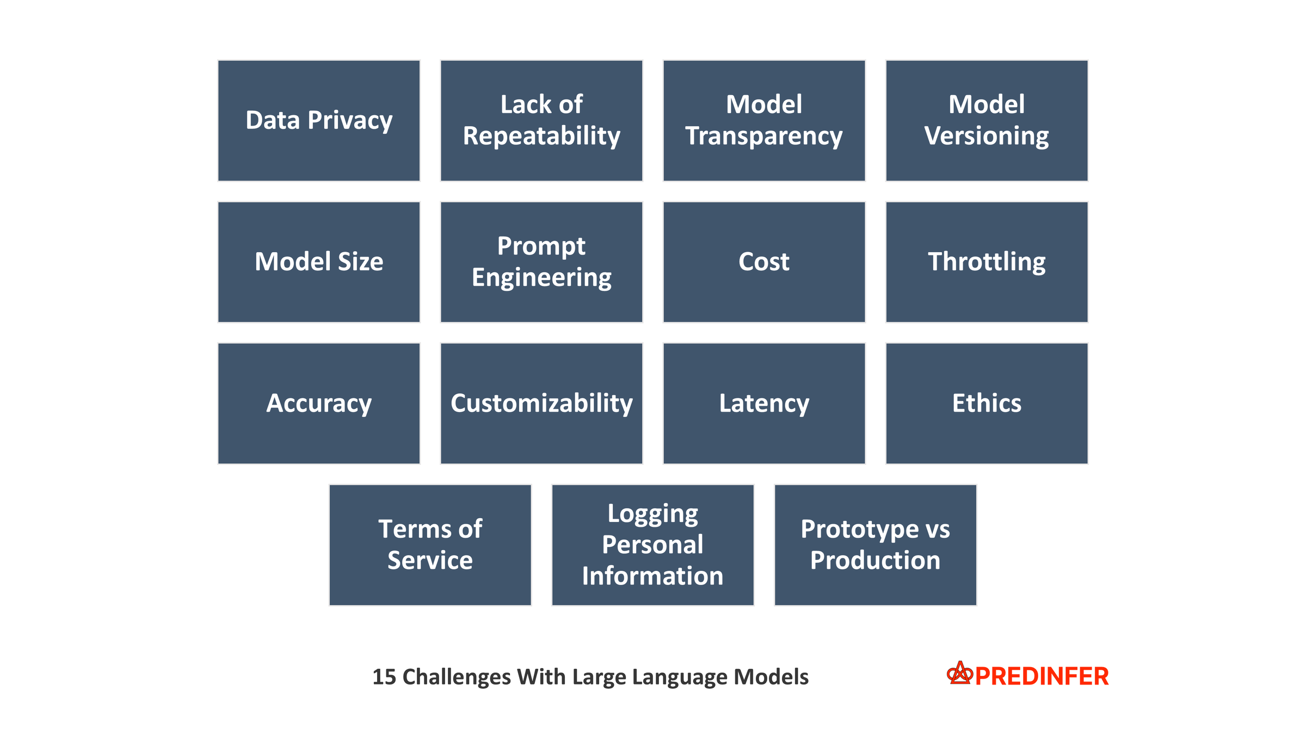

Slide 36
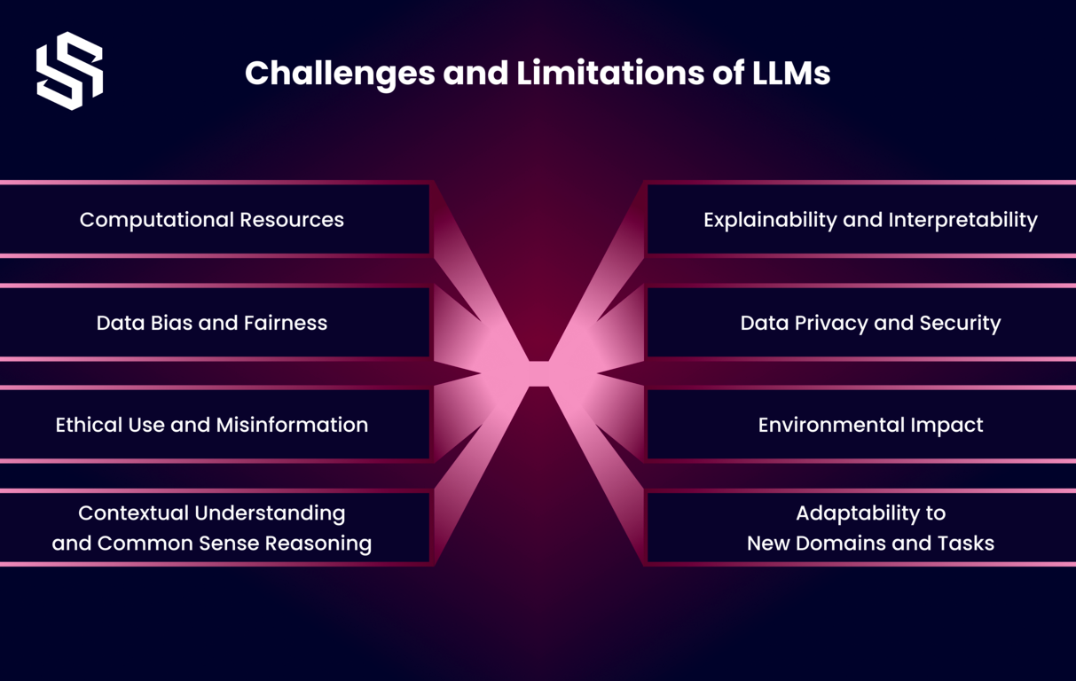

Slide 37

For any further inquiries or collaborations, please feel free to reach out:
MANAI MED MORTADHA :
CEO & Founder of @Man.Ai | Professional Technical Reviewer @Packt UK | AI Engineer | EX-Intern@Netflix &@Google | AI Instructor | Google Machine Learning Expert |Google DSC Mentor | Intel Certified Edge AI Developer | XAI Researcher
Linkedin: https://www.linkedin.com/in/mannai-mortadha/
GIithub : https://github.com/MortadhaMannai
Leetcode : https://leetcode.com/mannaimortadha898/
Sessionize: https://sessionize.com/Mortadha_Mannai/
Email : mannaimortadha898@gmail.com
Paper Link: https://zenodo.org/records/8274725

Slide 38


